Slide 1



Scalable Databases
Final Project - Phase 1 Amey Borkar(Year 2002) – Individual PPT

Slide 2
Contents:
Extracting the data
Table creation and data loading
Data Analysis Tasks
Top 3 airports with highest delay time
Top 3 airlines with highest delay time
Largest type of delay
Conclusion

Slide 3
Data Source:
Data Expo 2009: Airline on time data The data represents flight arrival and departure details for all commercial flights within the USA for all years
Download link: Data Expo 2009: Airline on time data

Slide 4
Steps for Working with data in Hadoop:
Step 1: Extracting the data from the site and download the csv file from the website.
Step 2: Creating a Hive table and load all the file data into it. Prefix the table name with your name.
Step 3: Displaying a first 100 rows.
Step 4: Data Analysis Tasks.

Slide 5
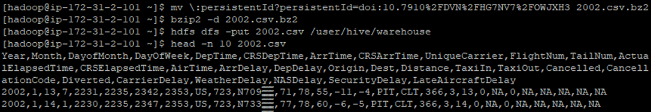
Step 1: Extracting the data from the site and download the csv file from the website.
A. For 2002.csv File:
hdfs dfs -mkdir -p /user/hive/warehouse -creating “warehouse” directory inside “hive” directory
hdfs dfs -chmod g+w /user/hive/warehouse - granting write permission to the group
wget https://dataverse.harvard.edu/api/access/datafile/:persistentId?persistentId=doi:10.7910/DVN/HG7NV7/OWJXH3
mv \:persistentId?persistentId=doi:10.7910%2FDVN%2FHG7NV7%2FOWJXH3 2002.csv.bz2
bzip2 -d 2002.csv.bz2 - unzip
hdfs dfs -put 2002.csv /user/hive/warehouse - Copying the new file back to HDFS

Slide 6
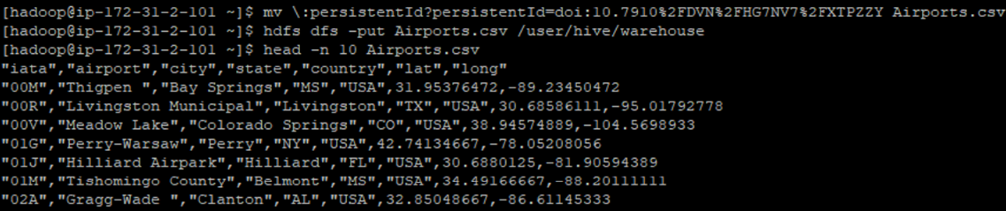
B. Airports.csv
wget https://dataverse.harvard.edu/api/access/datafile/:persistentId?persistentId=doi:10.7910/DVN/HG7NV7/XTPZZY
mv \:persistentId?persistentId=doi:10.7910%2FDVN%2FHG7NV7%2FXTPZZY Airports.csv
hdfs dfs -put Airports.csv /user/hive/warehouse - Copy the new file back to HDFS
head -n 10 Airports.csv -First 10 lines from csv file

Slide 7
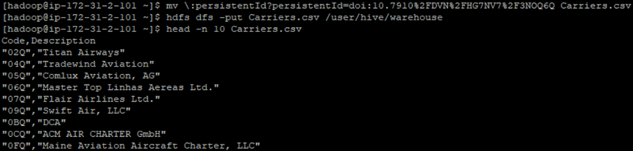
C. Carriers.csv
wget https://dataverse.harvard.edu/api/access/datafile/:persistentId?persistentId=doi:10.7910/DVN/HG7NV7/3NOQ6Q
mv \:persistentId?persistentId=doi:10.7910%2FDVN%2FHG7NV7%2F3NOQ6Q Carriers.csv - renaming the downloaded file as Carriers.csv
hdfs dfs -put Carriers.csv /user/hive/warehouse - Copy the new file back to HDFS
head -n 10 Carriers.csv -First 10 lines from csv file

Slide 8
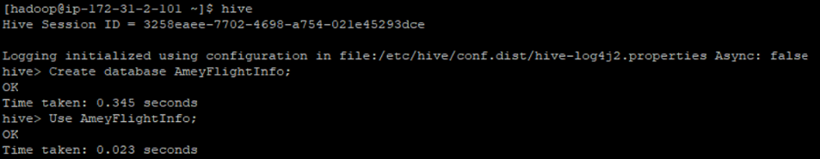
Step 2: Creating Hive database and tables to save the data
Use command hive to activate hive.
Create database AmeyFlightInfo; -creating new database “AmeyFlightInfo”
Use AmeyFlightInfo; -Using the new database
Creating the necessary tables & loading the data inpath

Slide 9
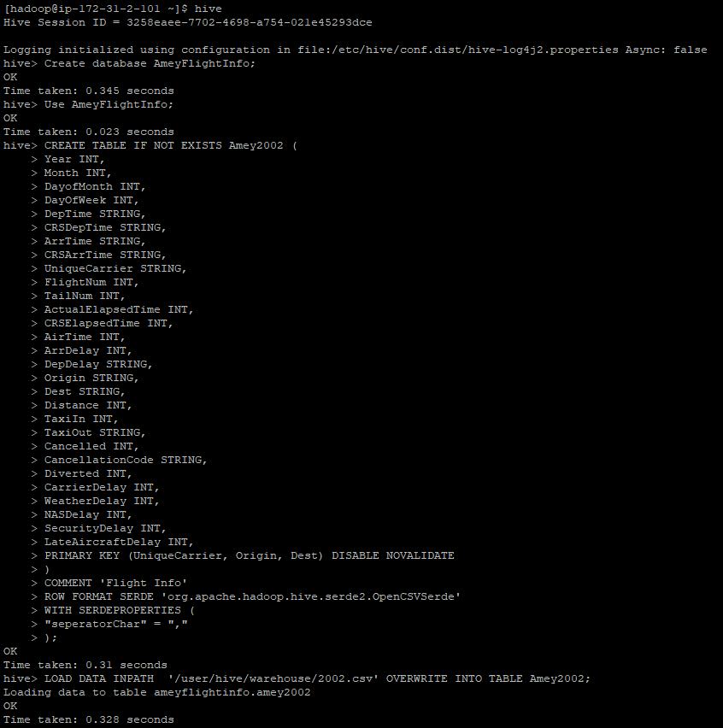

Slide 10
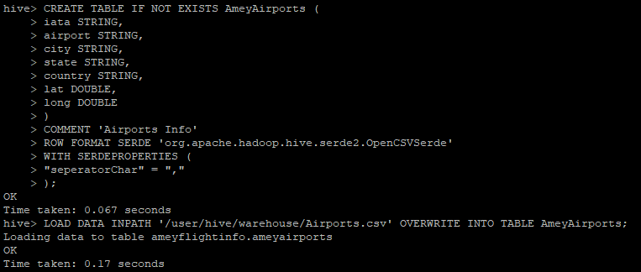
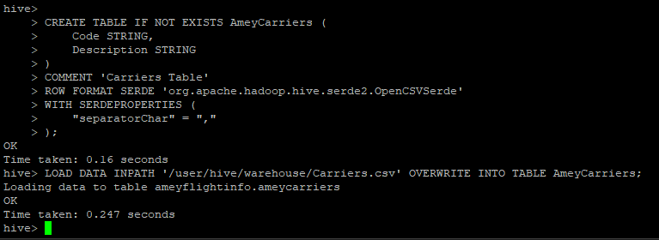

Slide 11
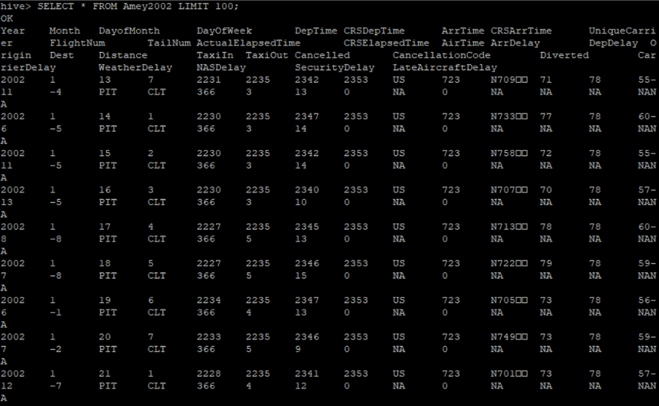
Step 3: Displaying 100 rows of the tables.

Slide 12
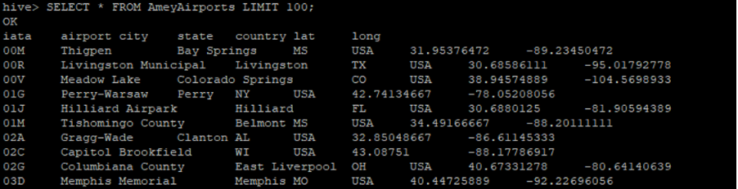
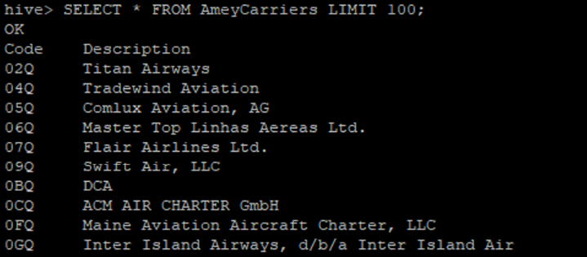

Slide 13
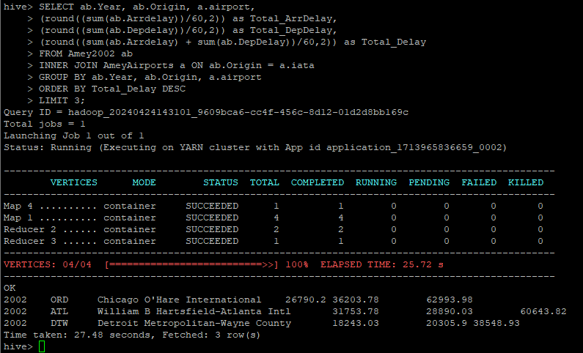
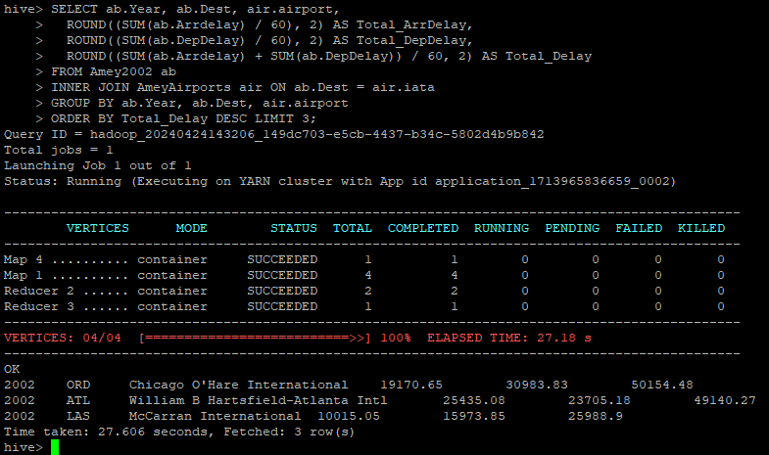
Step 4: Data Analysis
Determine the three airports with the highest delay time (in hours)
Year 2002
Origin & Destination

Slide 14
Determine the three airports with the highest delay time (in hours)
Year 2002
Origin Table
Top 3 Airports with Highest Delay (in Hours) by Origin
Name | Year | Origin | Airports | Arrival time Delay (In Hours) | Departure Time Delay (In Hours) | Total Delay (In Hours)
Amey | 2002 | ORD | Chicago O'Hare International | 26790.20 | 36203.78 | 62993.98
 |  | ATL | William B Hartsfield-Atlanta Intl | 31753.78 | 28890.03 | 60643.82
 |  | DTW | Detroit Metropolitan-Wayne County | 18243.03 | 20305.90 | 38548.93

Slide 15
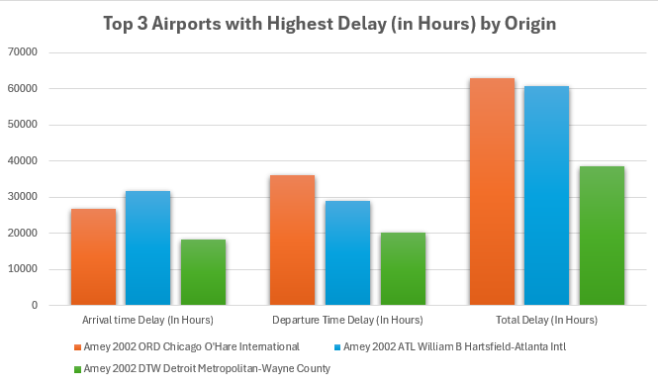
Determine the three airports with the highest delay time (in hours)
Year 2002
Origin Visualization

Slide 16
Determine the three airports with the highest delay time (in hours)
Year 2002
Dest Table
Top 3 Airports with Highest Delay (in Hours) by Destination
Name | Year | Destination | Airports | Arrival time Delay (In Hours) | Departure Time Delay (In Hours) | Total Delay (In Hours)
Amey | 2002 | ORD | Chicago O'Hare International | 19170.65 | 30983.83 | 50154.48
 |  | ATL | William B Hartsfield-Atlanta Intl | 25435.08 | 23705.18 | 49140.27
 |  | LAS | McCarran International | 10015.05 | 15973.85 | 25988.90

Slide 17
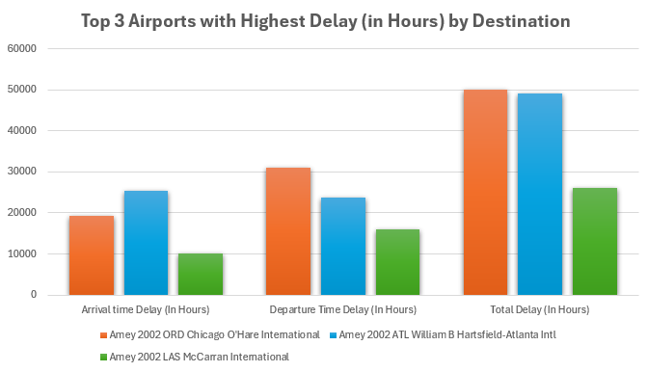
Determine the three airports with the highest delay time (in hours)
Year 2002
Dest Visualization

Slide 18
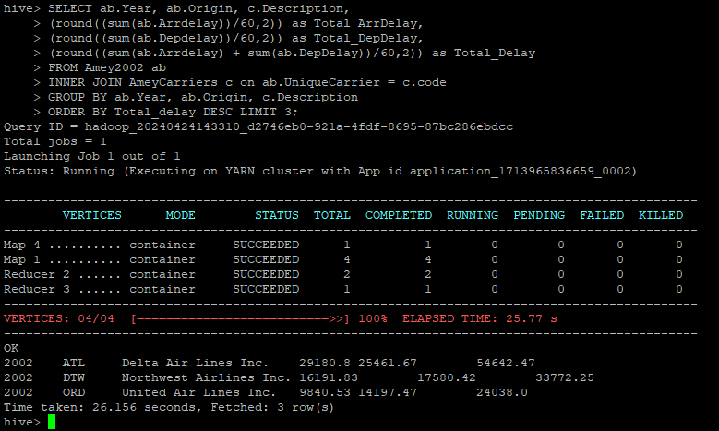
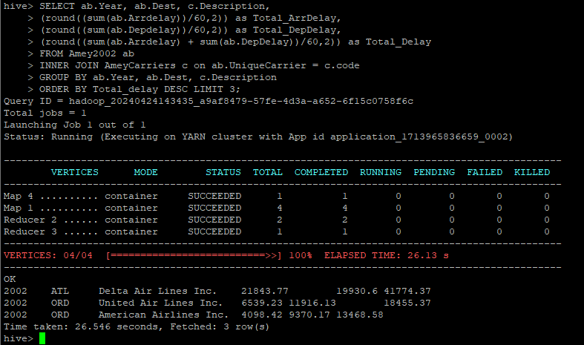
Step 4: Data Analysis
Determine the three Carriers with the highest delay time (in hours)
Year 2002
Origin & Destination

Slide 19
Determine the three Carriers with the highest delay time (in hours)
Year 2002
Origin Table
Top 3 Carriers with Highest Delay (in Hours) by Origin
Name | Year | Origin | Carriers | Arrival time Delay (In Hours) | Departure Time Delay (In Hours) | Total Delay (In Hours)
Amey | 2002 | ATL | Delta Air Lines Inc. | 29180.80 | 25461.67 | 54642.47
 |  | DTW | Northwest Airlines Inc. | 16191.83 | 17580.42 | 33772.25
 |  | ORD | United Air Lines Inc. | 9840.53 | 14197.47 | 24038.00

Slide 20
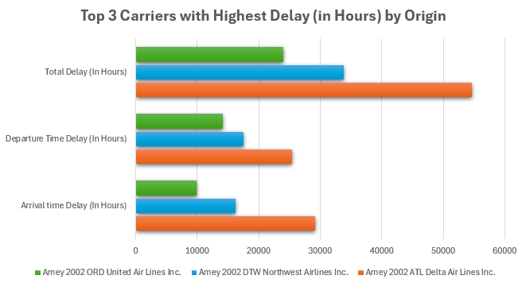
Determine the three Carriers with the highest delay time (in hours)
Year 2002
Origin Visualization

Slide 21
Determine the three Carriers with the highest delay time (in hours)
Year 2002
Dest Table
Top 3 Carriers with Highest Delay (in Hours) by Destination
Name | Year | Destination | Carriers | Arrival time Delay (In Hours) | Departure Time Delay (In Hours) | Total Delay (In Hours)
Amey | 2002 | ATL | Delta Air Lines Inc. | 21843.77 | 19930.60 | 41774.37
 |  | ORD | United Air Lines Inc. | 6539.23 | 11916.13 | 18455.37
 |  | ORD | American Airlines Inc. | 4098.42 | 9370.17 | 13468.58

Slide 22
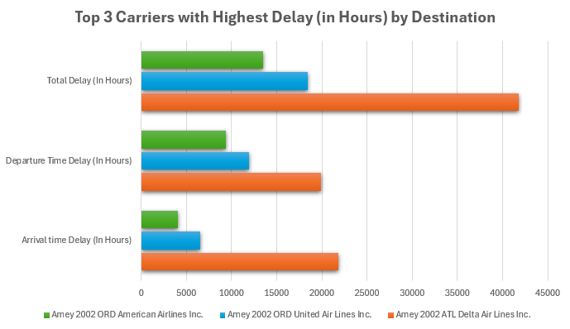
Determine the three Carriers with the highest delay time (in hours)
Year 2002
Dest Visualization

Slide 23
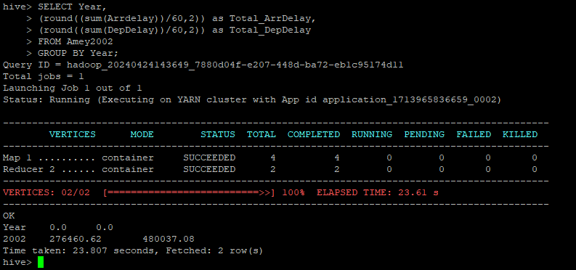
Step 4: Data Analysis
Determine overall which type of delay (arrivals or departures) is the largest for your airports
Year 2002
Origin & Destination

Slide 24
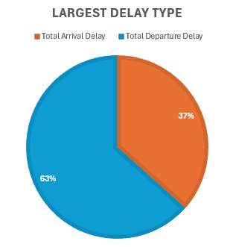
Determine overall which type of delay (arrivals or departures) is the largest for your airports
Year 2002
Table & Visualization
Year | Total Arrival Delay | Total Departure Delay | Largest Delay Type
2002 | 276460.62 | 480037.08 | Departures

Slide 25
Thank You!

